Slide 1
PRINCIPLES OF BIG DATA MANAGEMENT
Analysis of data collected on different categories of diseases
From twitter

Slide 2
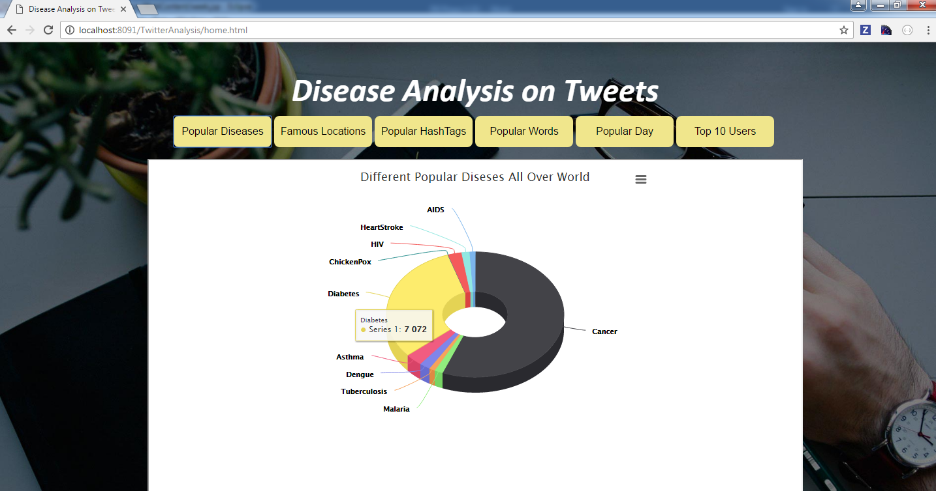
Tweet count on different diseases
In this query we are fetching maximum count of tweets done by a user on particular disease. This query is written using RDD. Initially for each disease the top tweeted user is fetched and UNION RDD is used to club all the diseases.
Visually, we used a PIE Chart to determine on which disease more number of tweets were posted. The visualization is done dynamically by passing the key value pairs to the jsp file for visualization.

Slide 3
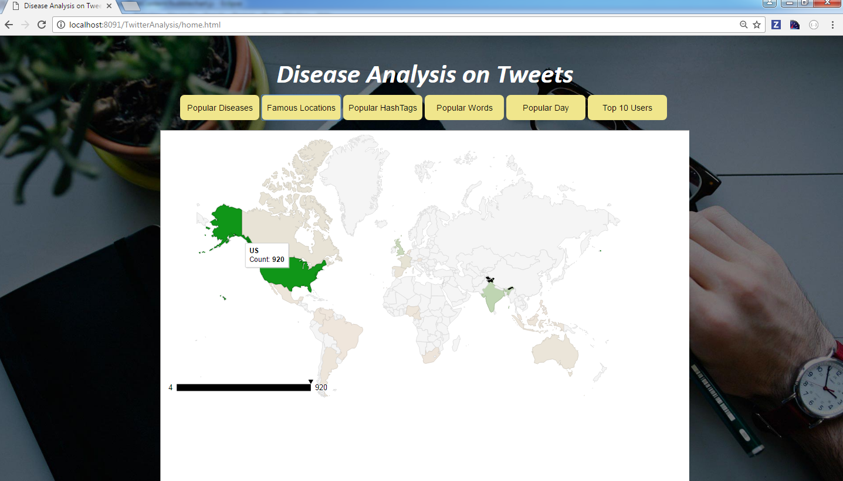
Countries that tweeted more on Diseases
In this query the top countries that tweeted more on diseases is fetched. First the location in tweets are fetched from tweets file and count is displayed as shown below
Visually, we used a google Map Chart to determine which country tweeted more number of tweets. The visualization isn’t dynamics though, in which we first run the scala code in Intellij and saved the output in a file and finally passed this file to Map chart.

Slide 4
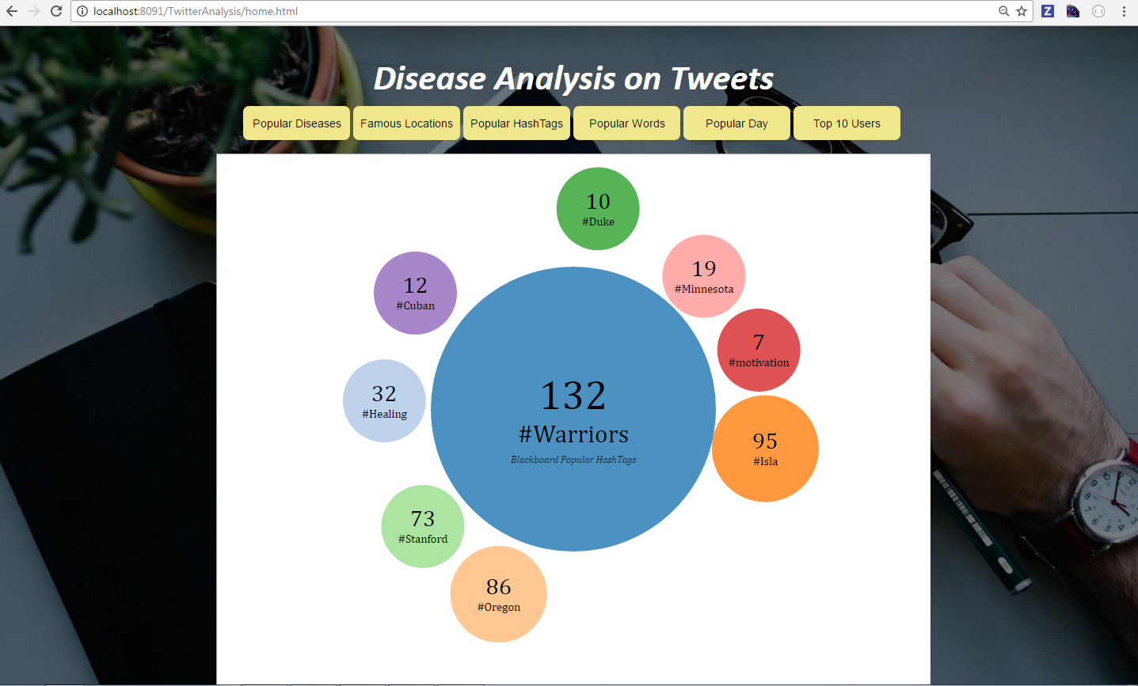
Popular HashTags
In this query, we took popular hash tags text file from blackboard and performed JOIN operation with hash tags from diseases tweets file.
We passed the csv file as an input for visualization and used bubbles to display the hash tags.

Slide 5
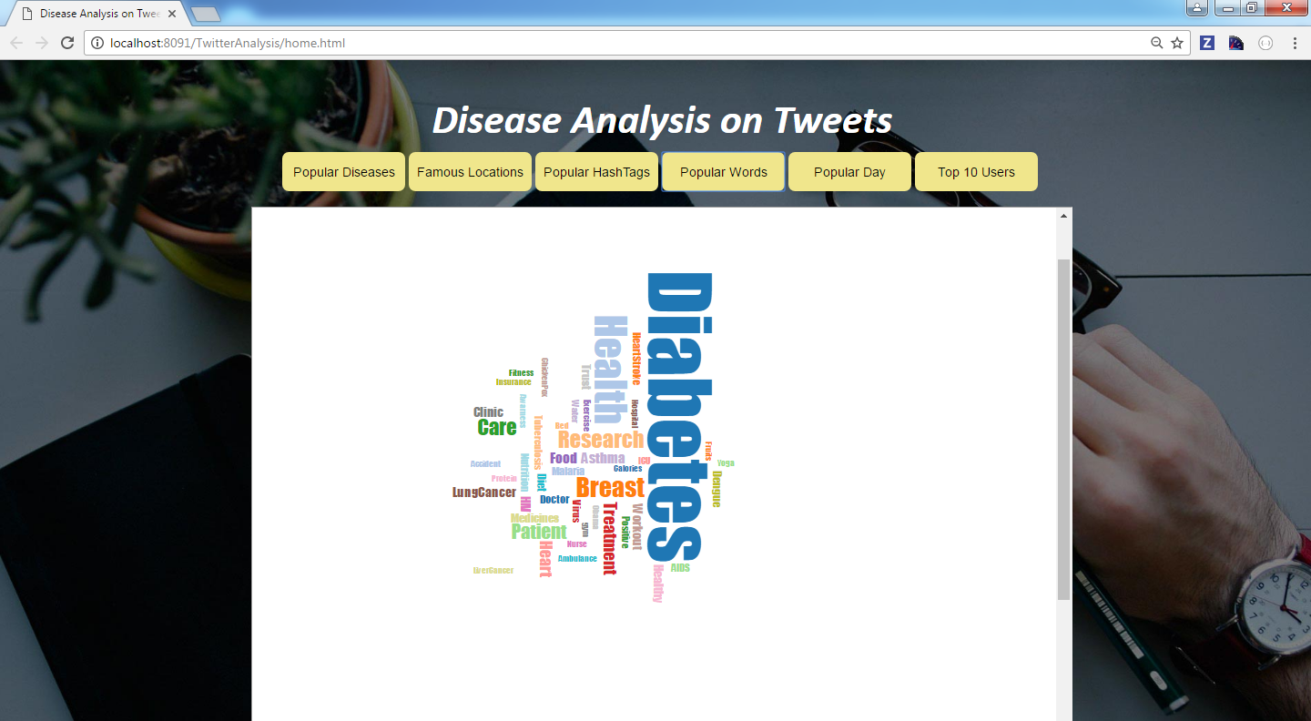
Popular Hashtags
Visually, we used a Chart to determine on which word, more number of tweets were posted. The visualization is dynamics though, in which we used servlet to connect front end with code and it would be able to scale the Bubble Chart accordingly.

Slide 6
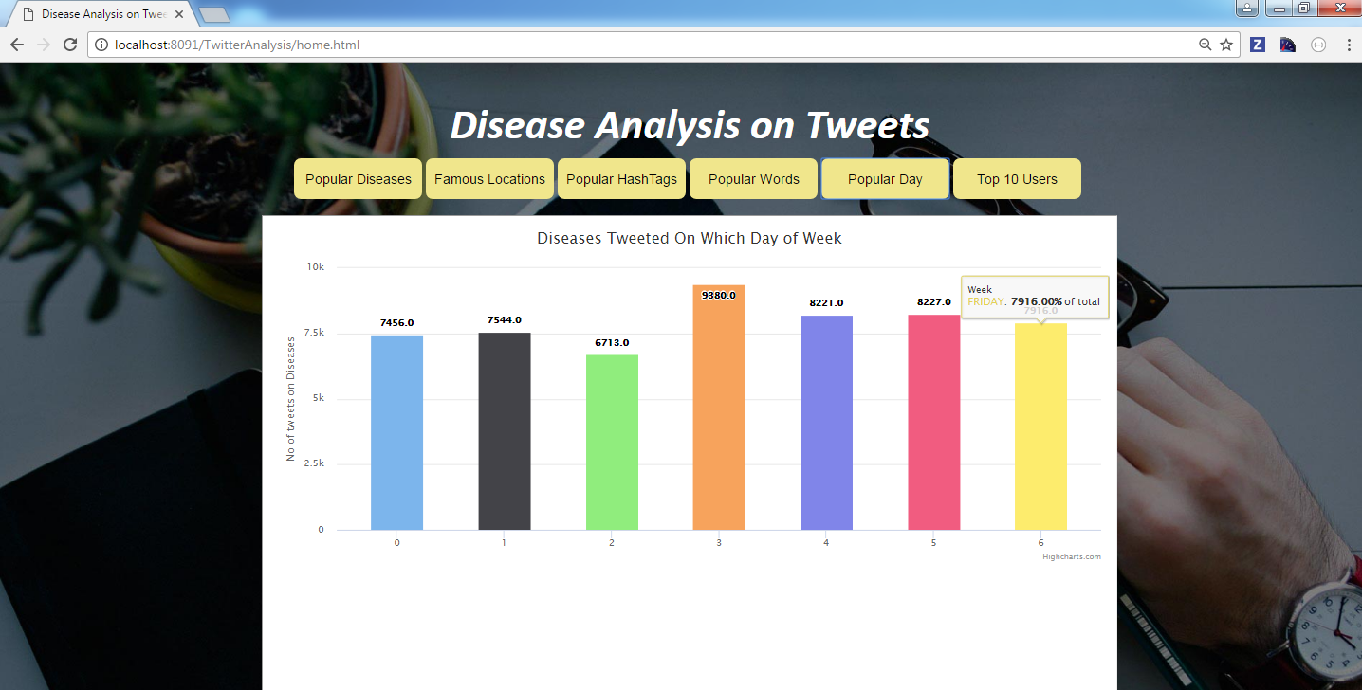
Tweets on different days of the week
In this query, data is fetched based which day of week more tweets are done on Diseases. Initially created at is fetched from tweets file and count of tweets is done on each week of day.

Slide 7
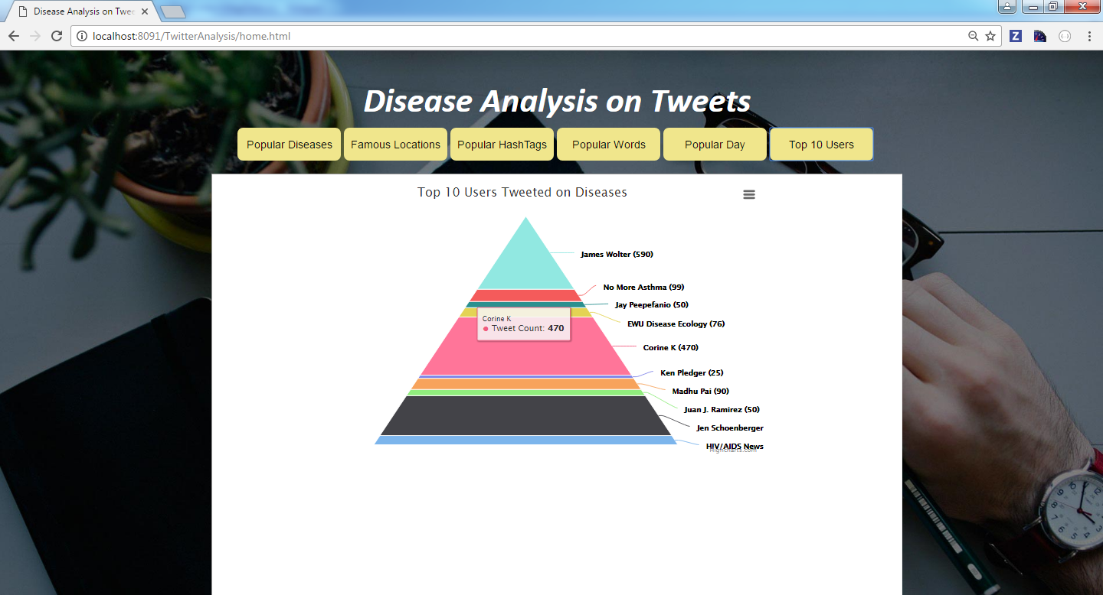
Top 10 Users
The top 10 users that tweeted on diseases.
For visualization we passed the key,value pairs to the JSP file and represented the data in a triangle.

